Slide 1
Unlock your Potential
kpmg.com.sa

Slide 2
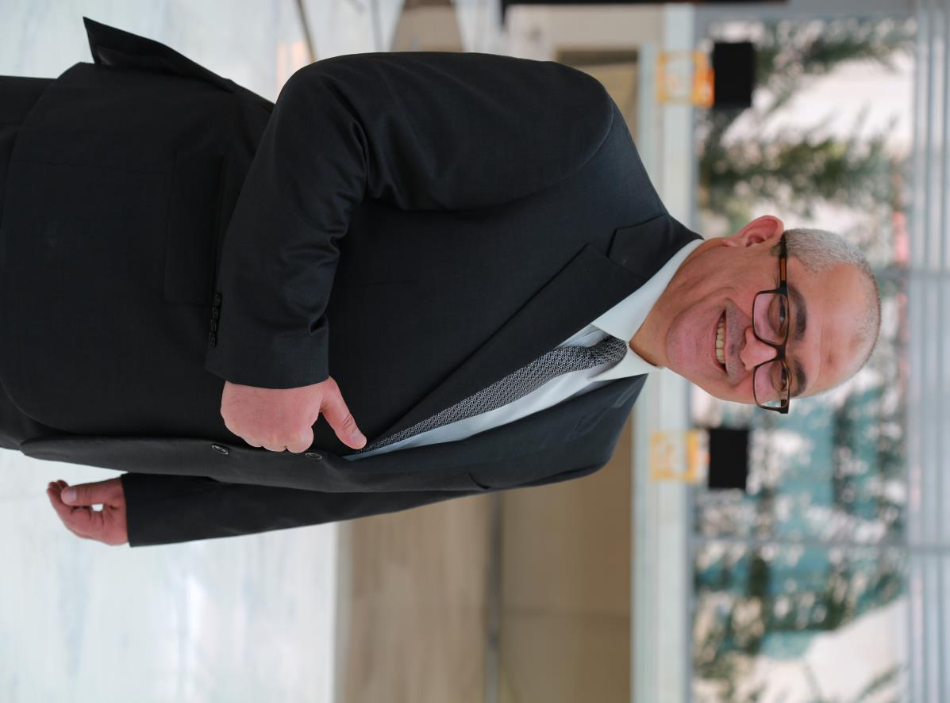
Hatem Kawasmy I’m here today to show you new opportunities and change your life... Believe me I’m serious! this session will be life changing! this is my promise to you…
kpmg.com.sa

Slide 3
Create Your Own World

Slide 4
Unsuccessful, Unhappy people think and talk about what they don’t wont

Slide 5
Successful people keep their thoughts and conversations on the topics of most desired goals

Slide 6
Living without clear goals is like driving in thick fog.

Slide 7
Your Automatic Goal – Seeking function

Slide 8
Homing Pigeon

Slide 10
Why People don’t Set goals?

Slide 11
They think goal aren’t important.

Slide 12
They don’t know How

Slide 13
They have a fear of failure

Slide 14
They have a fear of Rejection

Slide 15
Join The Top 3%

Slide 16
No Road Signs

Slide 17
Happiness Requires Goals

Slide 18
Happiness Requires Goals
1
You feel happy when you are making progress
Goals give you a sense of meaning and purpose
2
3
You feel more energized and effective
You feel more competent and confident in yourself
4
Goals enable you to control the direction of change in your life
5

Slide 19
Clarity is Everything

Slide 20
Develop
a Burring Desire

Slide 21
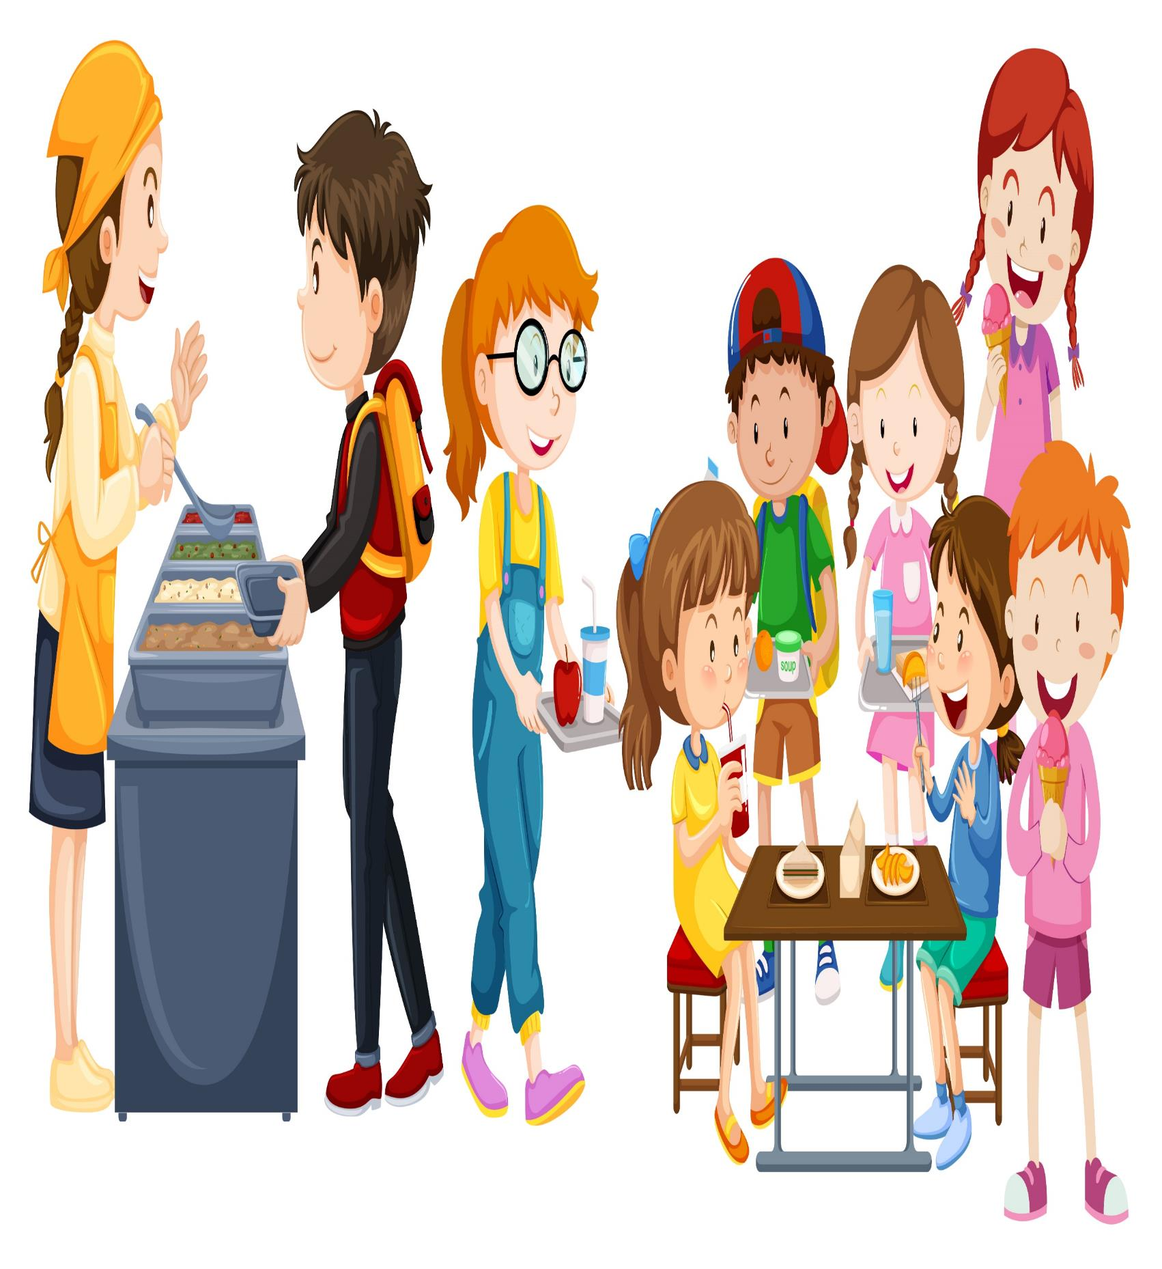
The Cafeteria model of success

Slide 22
The Restaurant model of success

Slide 23
The Key to Happiness

Slide 24
The Key to
Happiness
1
Setting goals
Habit of daily goals setting and achieving
2
3
Clear goals enable you to release your full potential for success
Goals enable you to overcome any obstacle and to make your future achievement
4
Goals enable you to control the direction of change in your life
5

Slide 25
Imagine that you have the inborn ability to achieve any goal you could ever set for yourself. What do you really want to be, have, and do?
UNLOCK YOUR POTENTIAL
1
What are that activities that give you your greatest sense of meaning and purpose in life?
2
Look at your personal and work life today and identify how your own thinking has created your world. What should you or could you change?
3
What do you think and talk about most of the time – what you want or what you don’t want ?
4
5
What is the price you will have to pay to achieve the goals that are most important to you?
6
What one action should you take immediately as the result of your answers to the above questions?

Slide 27
T H A N K
Y O U

